Slide 1

Capstone Design Team #14
Healthcare Telepresence Robot
Team Members:
Fernando Boaro
Chongdan Pan
Niyiqiu Liu
Ruixing Zhou
Tianyu Qiu
Sponsor:
Prof. Pradeep Ray
Instructor:
Prof. Yunlong Guo

Slide 2





Team Intro
潘崇聃 Chongdan Pan
Major in ECE
Team Leader
Overall Design
Source Provision
Fernando Boaro
Major in ME
Mechanical Design
Blueprint Sketching
刘倪逸秋 Niyiqiu Liu
Major in ECE
Control Coding
Function Testing
周瑞星 Ruixing Zhou
Major in ME
Mechanical Design
Structure Setup
邱天宇 Tianyu Qiu
Major in ECE
Circuit Design
Function Testing
2

Slide 3
Project Intro
Healthcare Telepresence Robot^{[1]}
Provide care
Caregivers
take care of
Too far…
the elderly
Communicate
3

Slide 4
Project Intro
Medicine Dispenser
Fall Detector
Video Call
Environment-aware
Healthcare
Telepresence
Robot
Remote Control
Movability
4

Slide 5
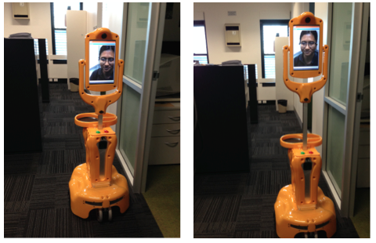
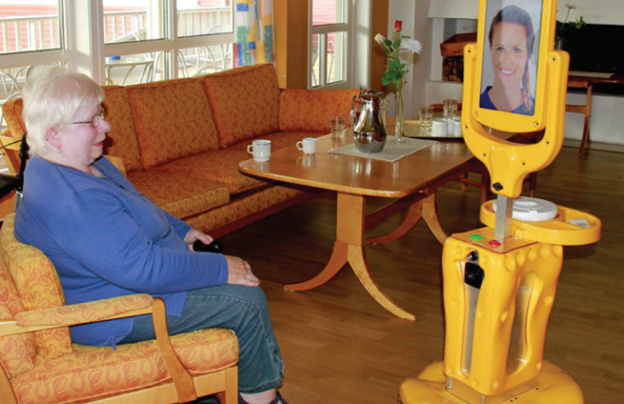
Newest Product: Giraffe Robot
Attributes^{[2]}:
Smart Medicine Dispenser
Fall Detector
Android-based App for Remote Monitoring
Screen Lifting
Figure 1: Appearance of Giraffe Robot^{[2]}
Figure 2: Giraffe Robot in Use^{[2]}
5

Slide 6
Newest Product: Giraffe Robot
Advantages^{[1]}:
Increasing feeling of happiness, sense of safety
Providing emotional connection between caregivers and old people.
Fall detection & Medication Dispenser
Disadvantages^{[1]}:
High cost, more than $5000
Fall detector malfunction
Firewall issues due to complex network structures
Drive Hardness due to video frame drop
Drive lag due to poor network.
6

Slide 7
General Requirement
Stable Remote Communication
Remote Control
Firewall Interruption Free
Short lags
Essential Functions
Video & audio Calls
Smart Medicine Dispenser
Fall Detector
Individual Customization
Low Budget
Less than $1000
Essential Function Realization
Simplification
7

Slide 8

Requirements & Specifications
Screen & Speaker
Suitable Height
Large Icon/Buttons
Acceptable DPI
Loud Speaker
Multiple Language Choices
Specifications
Quantitative Standard
Screen Height: 1m
Screen Size: 127mm$×$170mm (7 inches)
Icon Size: 20mm$×$20mm
DPI: 1280$×$720 pixel
Loudness: 80dB
Multiple (at least 3) Language Support
Qualitative Standard
Volume Adjustment
Font Size Adjustment
8

Slide 9

Requirements & Specifications
Medicine Dispenser^{[3][4]}
Suitable Height
Large, Cool, Storage
Alarm for Notification
Specifications
Quantitative Standard
Dispenser Height: 0.7m
Storage Space:
21 blocks (dose for 7days, 3times/day)
Storage Temperature: 15$℃$
Qualitative Standard
Smart, Adjustable Alarm
9

Slide 10
Requirements & Specifications
Robot
Suitable Moving Speed
Long Battery Duration
No Sharp Edges
Specifications
Quantitative Standard
Moving Speed: 0.2m/s
Battery Volume:
20000mAh
Qualitative Standard
Fillets replacing Right-angles
Soft Cushions against Collision & Cutting
10

Slide 11
Requirements & Specifications
Software
Easy Control
Obstacle Detection
Internet Access
Privacy Protection
Specifications
Quantitative Standard
Detection Radius: 1.5m
Access to any function within 3 steps
Qualitative Standard
IPV6 Protocol Support
Password Requirement
11

Slide 12
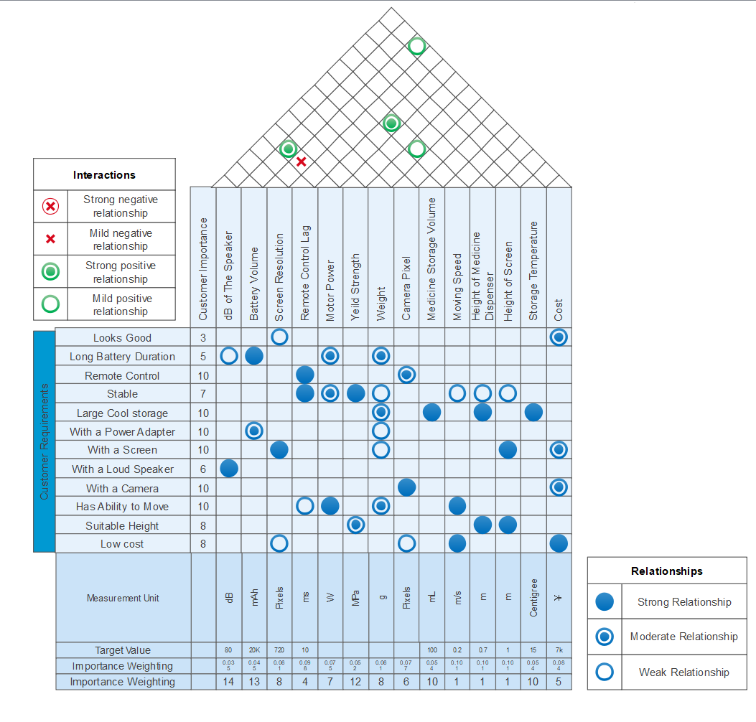
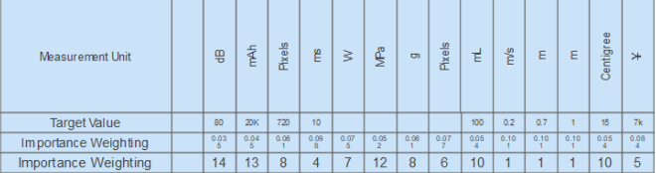
Quality Function Deployment
Figure 3: Quality Function Deployment Chart
12

Slide 13
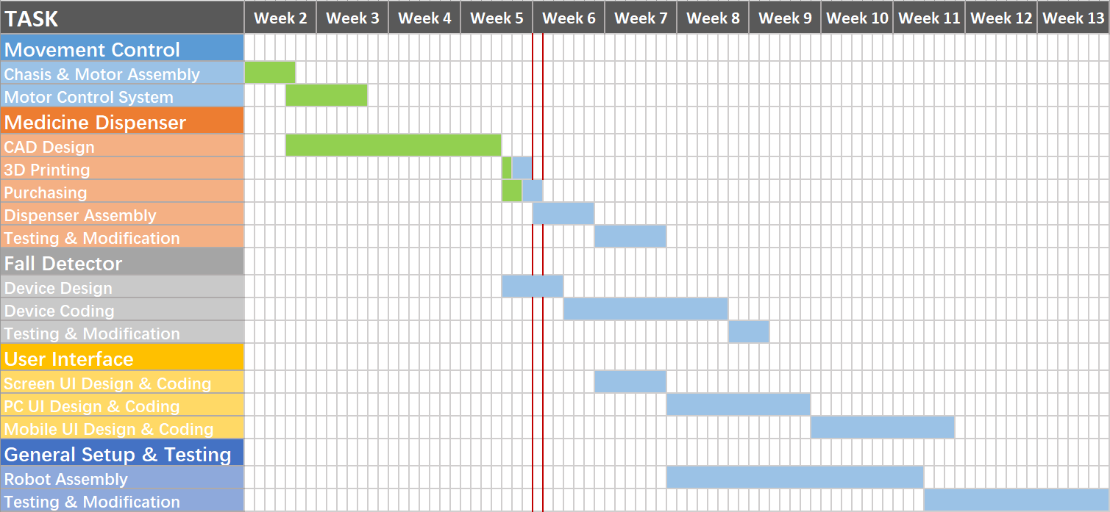
Project Schedule
Figure 4: Project Gantt Chart
13

Slide 14
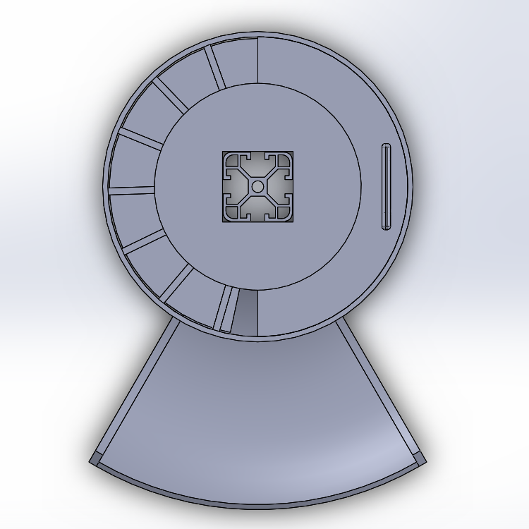
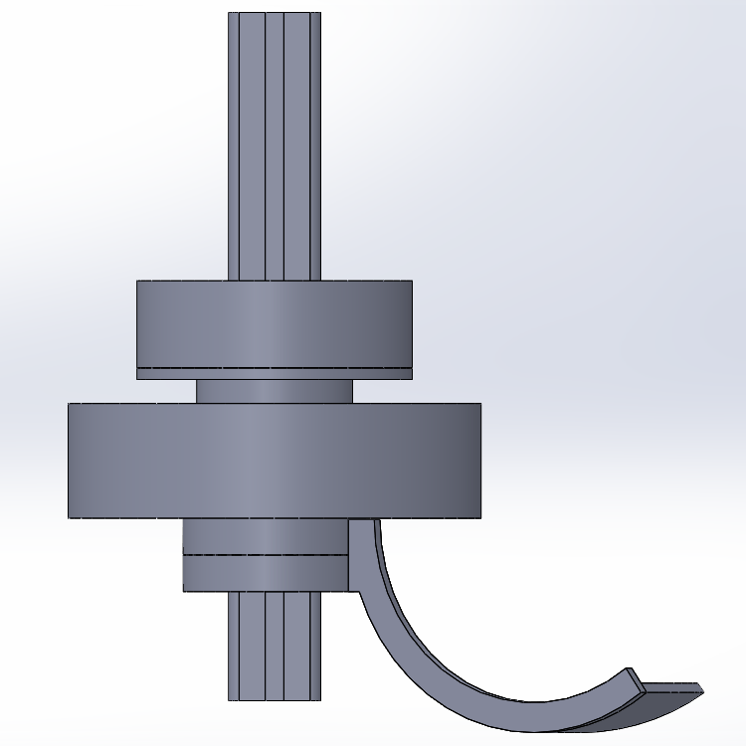
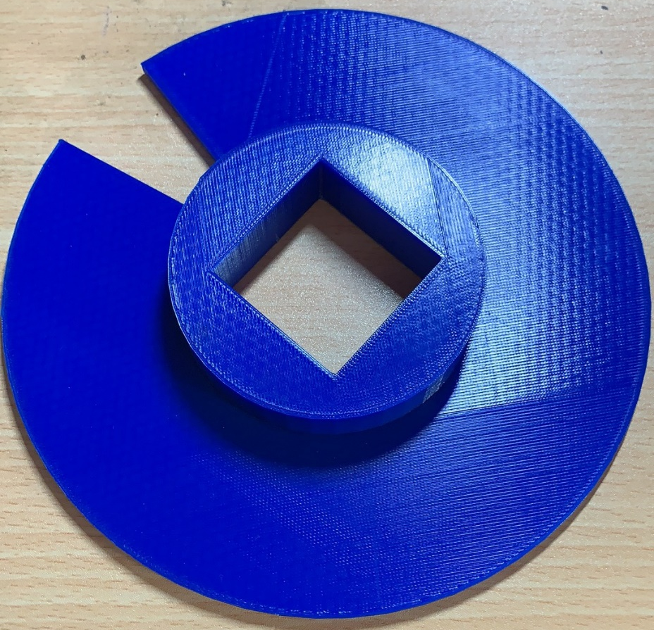
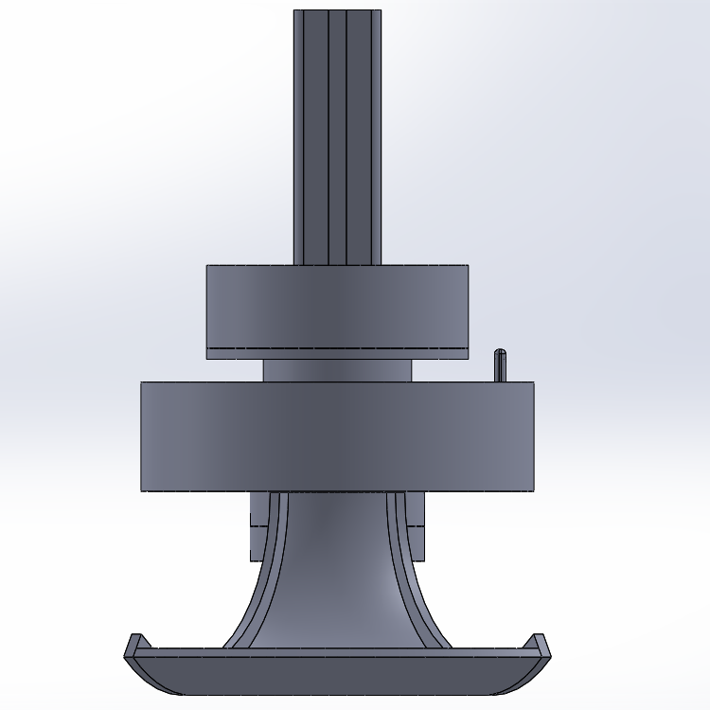
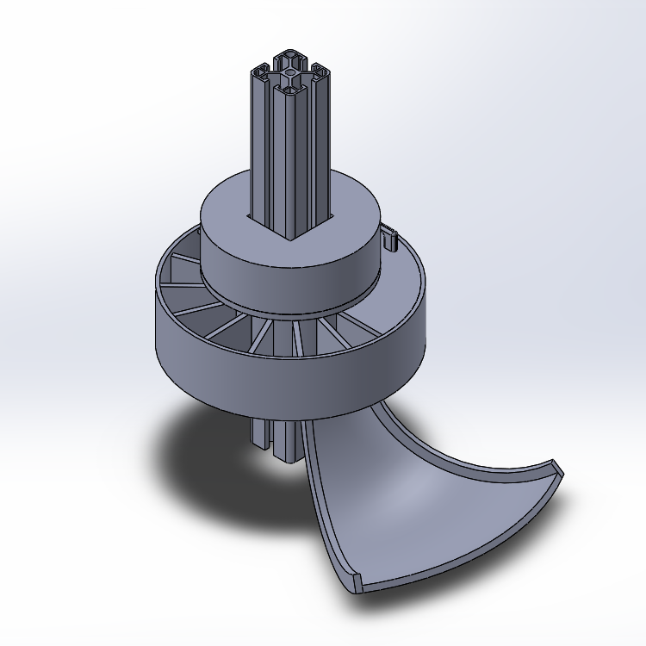
Main Progress
Medicine Dispenser Design
Figure 5: 3D Model for Medicine Dispenser
Figure 6: Structure made by 3D Printing
14

Slide 15
Q & A
15

Slide 16
References
G. Zhang, J. P. Hansen, K. Minakata, A. Alapetite and Z. Wang, "Eye-Gaze-Controlled Telepresence Robots for People with Motor Disabilities," 2019 14th ACM/IEEE International Conference on Human-Robot Interaction (HRI), Daegu, Korea (South), 2019, pp. 574-575.
Donald Kerr, J Artur Serrano, Pradeep Ray, “ The role of a disruptive digital technology for home‑based healthcare of the elderly: Telepresence robot ," Digital Medicine, Year 2018, Volume 4, Issue 4 [p. 173-179]
Reeder, Blaine, et al. “Older Adults' Satisfaction with a Medication Dispensing Device in Home Care.” Informatics for Health & Social Care, U.S. National Library of Medicine, Sept. 2013, www.ncbi.nlm.nih.gov/pmc/articles/PMC4122419/.
Sumo Guide. “Best Automatic Pill Dispenser - Top 10 Reviews 2019.” Sumo Guide | The Ultimate Shopping Guide & Product Reviews, Sumo Guide Team Https://Sumoguide.com/Wp-Content/Uploads/2016/09/Sumo-Guide-Logo-300x100.Png, 31 July 2019, sumoguide.com/best-automatic-pill-dispenser-reviews/.
16

